Slide 1
Masked Feature Phoneme Model CI 6/12/23
Owen MacKenzie

Slide 2
Review of Last Weeks Work

Slide 3
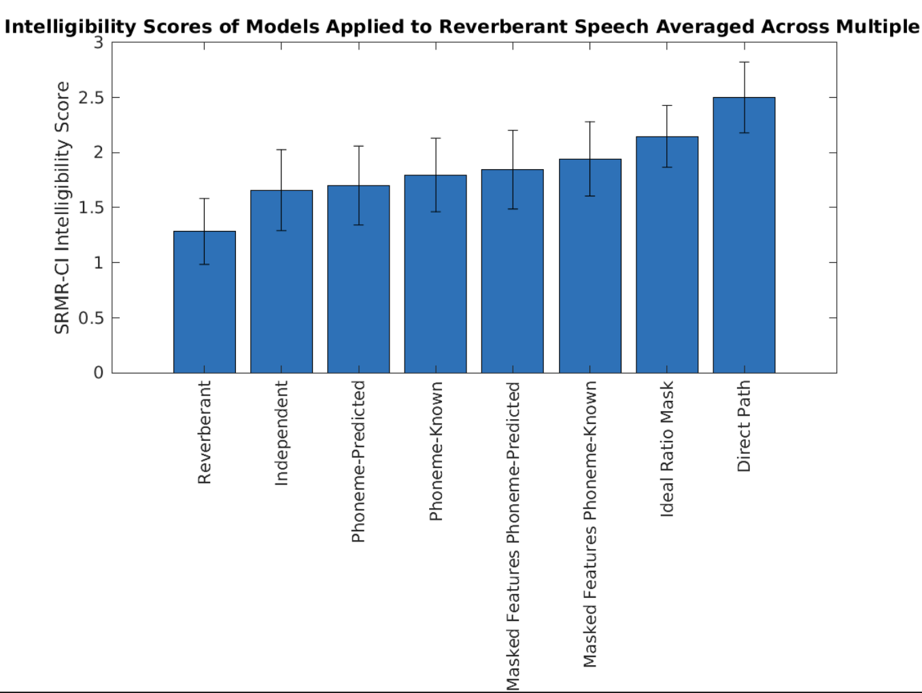

Slide 4



Comparison of Predicted Phoneme to Known Phoneme Masked Features
(1.820 for masked features - 1.736 for Kevin’s best result = 0.084 improvement)

Slide 5
Viable Model with Highest Intelligibility Scores: Phoneme Model using Predicted Phonemes and Masked Features
Improvement from 1.705 to 1.897 using predicted phonemes which is viable unlike model using known labels
Training Specifics
For each testing file in Libri-speech database a random reverberant condition from BUT database is applied: 8000 samples
The reverberant STFT, IRM Mask, and phoneme labels are extracted
There is a mask model for each phoneme, so each training step involves iterating over all the phonemes to train all the models
A phoneme mask from the known labels is applied to only use time steps where the KNOWN phoneme is present.
Sigapprox loss is used to compare the output of the model to the IRM Mask at those specific timesteps where the phoneme is present
Masked Features
Previously the phoneme mask models each took in the reverberant STFT as the input. For the masked features a mask independent of phonemes is created via the independent model. The pointwise multiplication product of the mask and rev features becomes input.

Slide 6
Clarifying Phoneme Classification in Results
For the two phoneme-predicted models (with input to phoneme mask models as reverberant features and masked features) both used the same phoneme classification model
Previously I did not manipulate for the masked feature model where masked features were used – so BOTH the phoneme classifier and phoneme mask models received masked features
0.3 x
Masked Features
“a” Mask Model
“a” out
Masked Features
Phoneme Classifier
+
0.5 x
Masked Features
“b” Mask Model
“b” out
+
0.2 x
Masked Features
“c” Mask Model
“c” out
= model out

Slide 7
Where to go from here: investigating phoneme classification

Slide 8
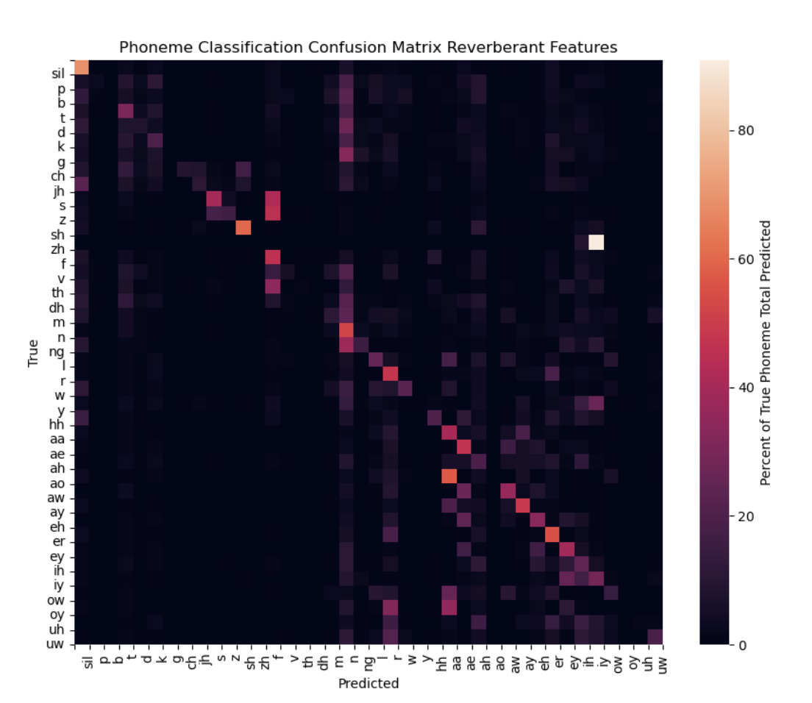
Phoneme Classification on Reverberant Features = 28.1%

Slide 9
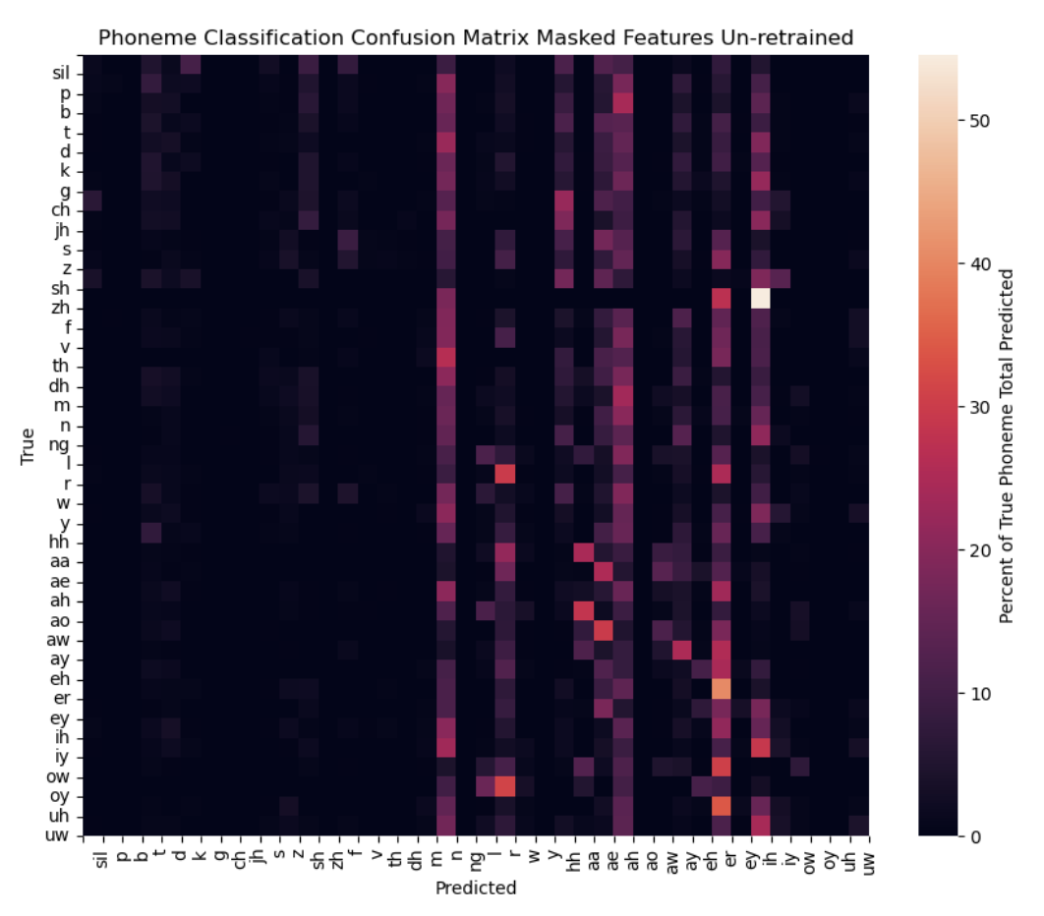
Phoneme Classification on Masked Features = 8.8%

Slide 10
Why so Much Worse?
The phoneme classifier was trained to expect reverberant features and return the probability that each phoneme is present
But instead it is receiving masked features
Can we retrain it so that it is trained to accept these masked features? And will that make it perform better?

Slide 11
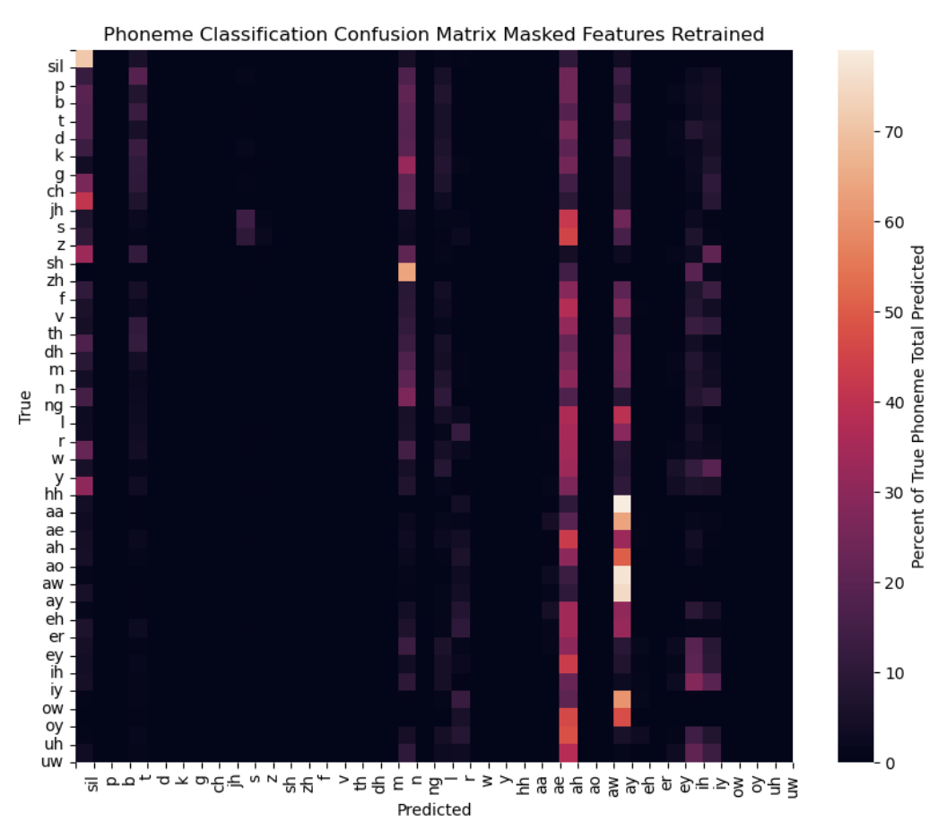
Retrained Phoneme Classification on Masked Features = 10.6%

Slide 12
Results

Slide 13
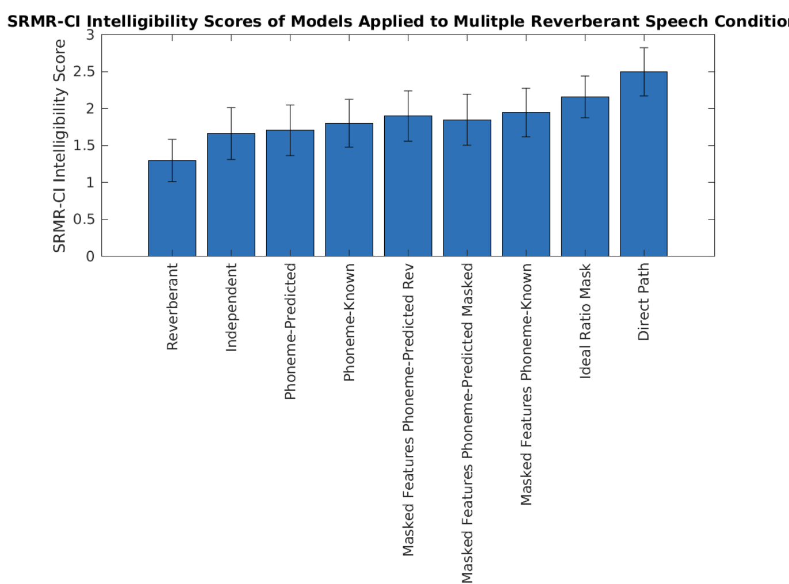

Slide 14
Summary of Results
rev 1.2962038595175374
ind_est 1.660744545196745
pho_soft 1.7050972207963342
pho_known 1.8003010940464452
pho_masked_soft_rev 1.8971016986141545
pho_masked_soft 1.848809535203496
pho_masked_known 1.944178413790819
ideal 2.156781547234233
dp 2.496276760237723

Slide 15
Work in Progress and Next Steps

Slide 16
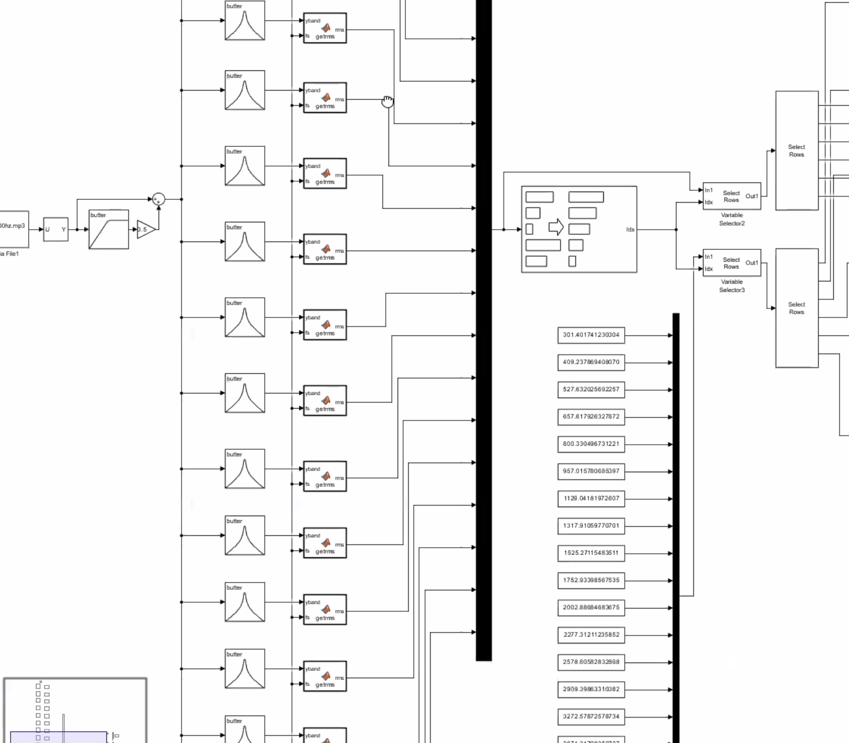
Work with Zach and Simulink Vocoder
Masked Features
Phoneme Classifier
Zach’s Model

Slide 17
Idea to reduce phoneme classification
Instead of training using known phonemes, use the phoneme predictions. Realizing that there are only a few phonemes that actually get predicted but results still go up we can leverage that to require less models

Slide 18
Masked Feature Phoneme Model CI 5/24/23
Owen MacKenzie

Slide 19
Changes to the Code
independent_model.py and phoneme_based_model.py
load_model(model_dir)
Uses pathnames to load the scalar and model or experts for each bpg
predict_model(single X sample, model, scalar, bpg (if p_b_m) )
Passes a single sample through the model and returns predicted mask
Instead of requiring loading and predicting to all happen in the same evaluate.py script and operate on all files at once, this offers much more control and allows for passing a single X in dataLoader
fileLoaderOWEN.py
Looks in the conf file for a masked_features key to see if masked features are required
Loads the independent model in the _init_ function of Dataset so it is done only once
_getitem_ is modified so if masked features are used the independent model predicted mask is retrieved using the predict method. Then this is multiplied by X to become the new X used

Slide 20
Changes to the Code Continued
evaluate_phoneme_based_modelsOWEN.py
If masked_features is in the conf_dict, then pass X through the independent model to get that mask and multiply like in the file loader
Then at the end instead of saving the predicted mask for the 2nd layer phoneme model, multiply both the independent and phoneme masks together and save this product – multiplication is commutative!
evaluate_and_calculate_srmr.py
Puts all the evaluation in one place
Given model parameters it first runs the regular evaluate code (independent or phoneme_based depending on the params)
Then uses python’s matlab engine to run the srmr intelligibility matlab code on those parameters from python
A few scripts for collecting intelligibility results and generating matlab plots from python

Slide 21
Results

Slide 22
Experiment 1: Small Testing Batch CUNY Female with Lecture Reverberance
Only 10 samples – will bump up to 50 female, 50 male
Only lecture reverberance – will do 2x lecture, office, aula, stairway and average results (also show average for each room)
No noise – will incorporate SNR experiment with heater, traffic, babble to the new masked features phoneme model

Slide 24

Reverberant (1.44) – what a CI user would hear without any model masking applied and our lower bound

Slide 25

Phoneme Independent Model (1.70) – LSTM sigapprox model that does not leverage any differences between phonemes

Slide 26


Phoneme Dependent Model with Predicted Phoneme Classification
(1.743 for the model I retrained, 1.736 for Kevin’s model)
– LSTM sigapprox model that passes features through phoneme classifier and a different model for each phoneme. Weights the outputs of phoneme models based on classification results

Slide 27


Phoneme Dependent Model with Known Phoneme Weighting
(1.831 for the model I retrained, 1.833 for Kevin’s model)
– LSTM sigapprox model that passes features through a different model for each phoneme. Weights the outputs of phoneme models based on the known phoneme present instead of classification results

Slide 28

Masked Feature Phoneme Model with Known Phoneme Weighting (1.820)
– 2 layer model that first passes features through the independent sigapprox model and then passes the masked output features generated by this model through a different model for each phoneme. Weights the outputs of phoneme models based on classification results on the masked features.

Slide 29

Masked Feature Phoneme Model with Known Phoneme Weighting (1.930)
– 2 layer model that first passes features through the independent sigapprox model and then passes the masked output features generated by this model through a different model for each phoneme. Weights the outputs of phoneme models based on the known phoneme present instead of classification results

Slide 30


Ideal Ratio Mask (2.12) Direct Path (2.65)
Cheat by using the clean signal to calculate the mask or are the clean signal. This is not accessible to the CI, only the reverberant signal is received. Represents the upper bound

Slide 31
Analysis

Slide 32

Comparison of Known Phoneme to Known Phoneme Masked Features
(1.973 for masked features - 1.831 for Kevin’s best result = 0.142 improvement)

Slide 33
Comparison of Predicted Phoneme to Known Phoneme Masked Features
(1.820 for masked features - 1.736 for Kevin’s best result = 0.084 improvement)

Slide 34
Further Exploration
Evaluate on a larger more diverse testing set
Refer to Kevin’s code to see if he did any processing other than simple multiplication of the mask by the reverberant STFT
Simple fix to not assume first layer is independent model and instead use conf_dict params to load/predict ind or p_b_m
Simple fix to use recursion and look at conf-dict of masking model so we can stack multiple phoneme and independent models together
Understanding that computation time is a factor of course!
Evaluating phoneme classification performance of the masked feature model
Listen to the signal because could be smoothing it out too much

Slide 35
Masked Feature Phoneme Model CI 6/5/23
Owen MacKenzie

Slide 36
Results

Slide 37
Evaluate on Larger Testing Set:
Librispeech used for training and 100 random CUNY female samples for testing (not the same 100 for all conditions so more diverse)
This makes conclusions between rooms weaker, but this is less of a focus and is usually clear anyway
But the same test sets are used for comparing each of the models
BUT RIR dataset used for training and AIR used for testing
RIR conditions
Lecture (013 and 113)
Office (013 and 113)
Stairway (013 and 113)
Aula Carolina (013 and 113)

Slide 38
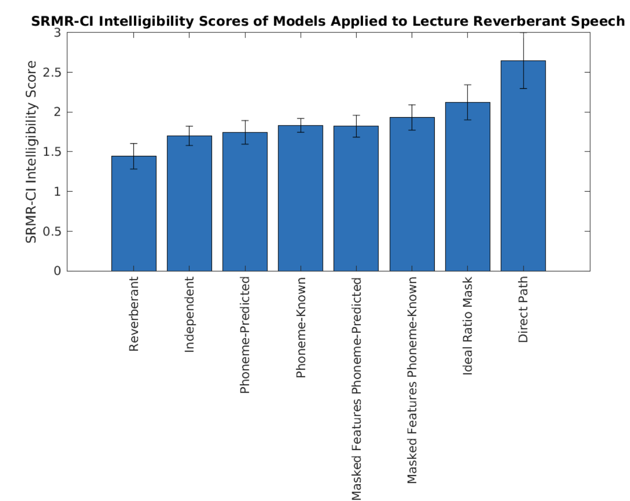

Slide 39
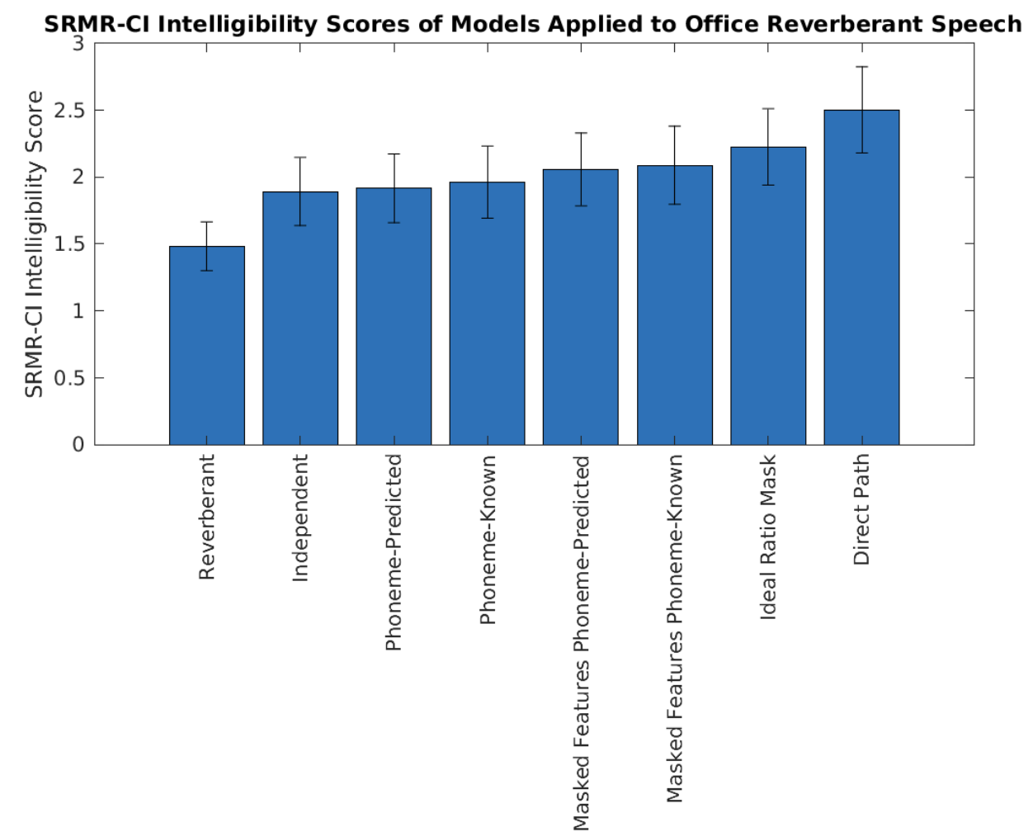

Slide 40
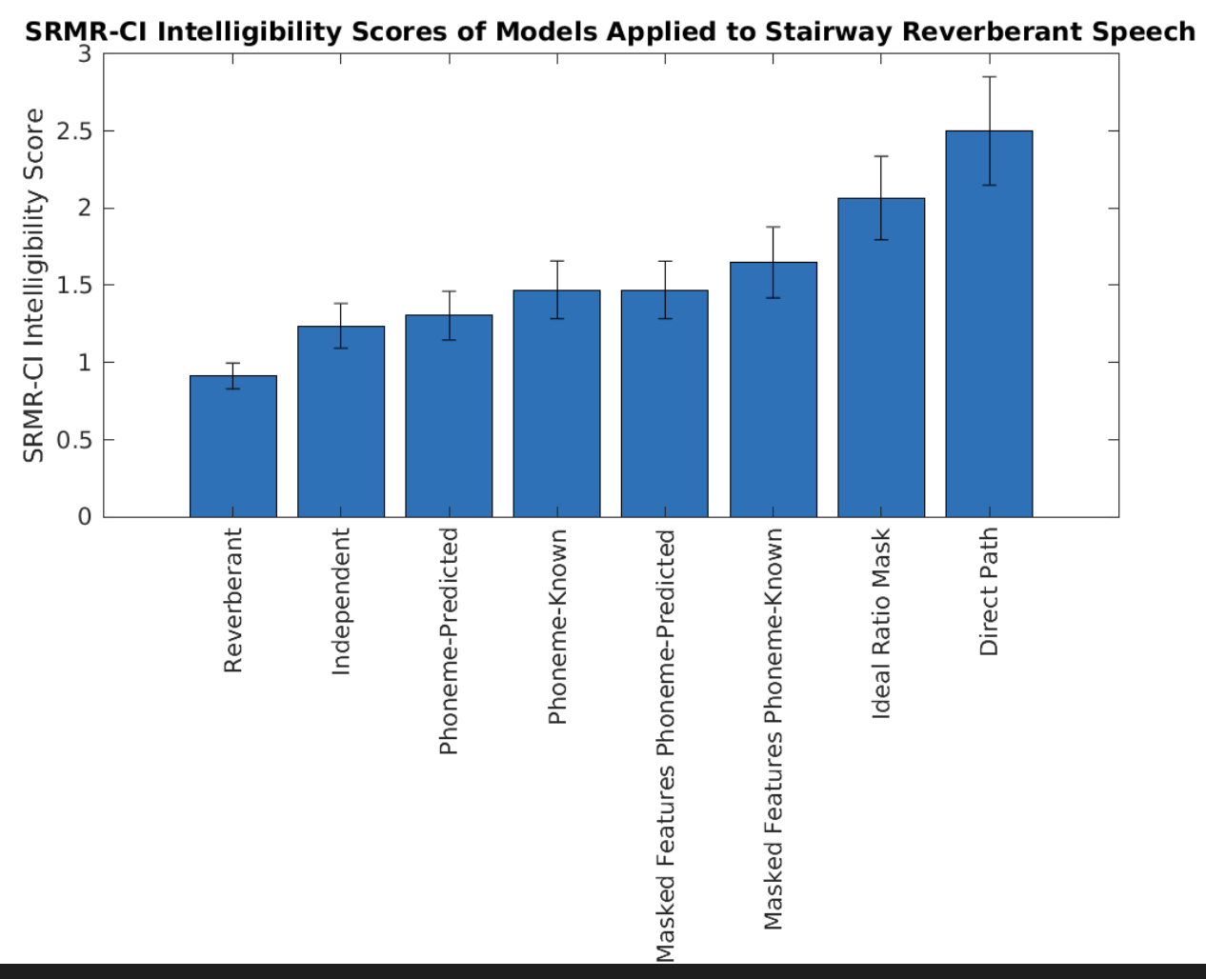

Slide 42
Evaluate Phoneme Classification
Phoneme classification model: librispeech_arpabet phoneme
Compare classification performance on reverberant features and masked features
Use the same CUNY testing files with AIR RIR rooms
Get masked features by finding the independent model mask file and multiplying it by the reverberant features
Struggled with using the load and predict code because mask estimation is in a different directory than phoneme classification so can’t import mask code easily

Slide 43
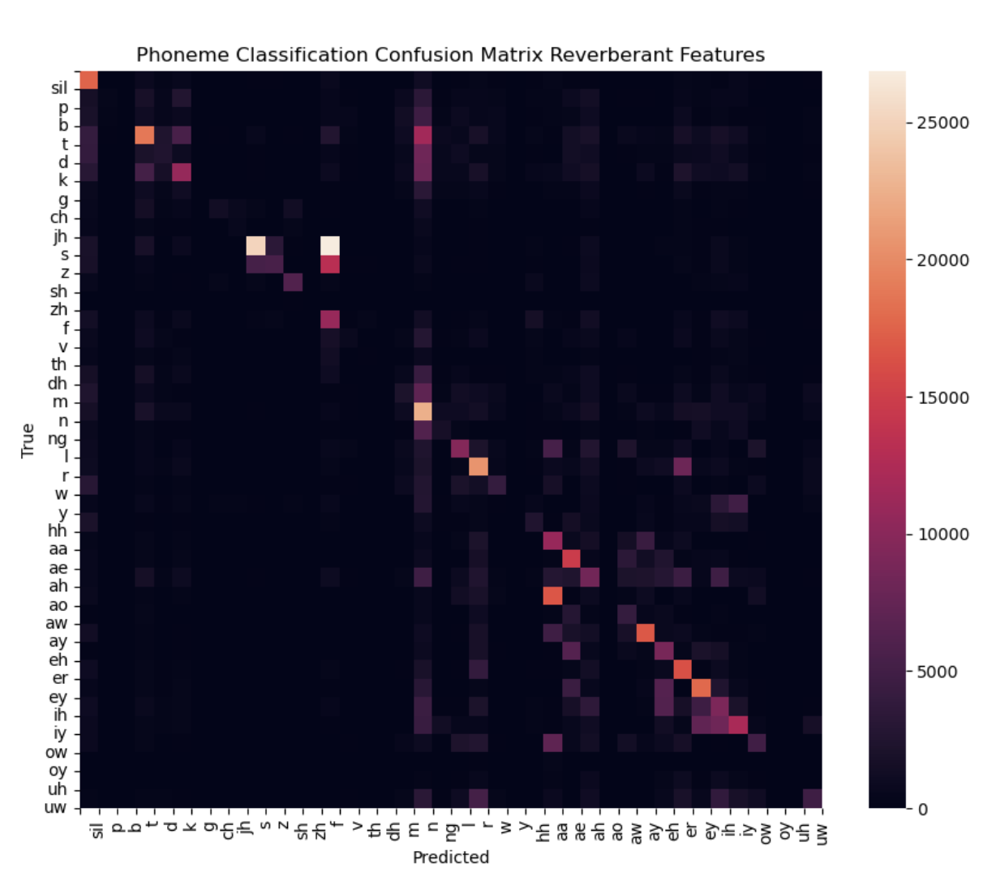
Reverberant Features: Accuracy = 28.992%

Slide 44
Masked Features: Accuracy = __%

Slide 45
Other Progress
While waiting for code to run (a long time) worked on cleaning up the process for getting predicted masks and plotting
Also worked on generating my test_sets
They are randomized choosing 100 of all 720 cuny female
Worked on trying to make this 50 male, 50 female but ran into issues with feature extraction
Reminder for me to keep working on
Not assume first layer is independent model and instead use conf_dict params to load/predict ind or p_b_m
Use recursion and look at conf-dict of masking model so we can stack multiple phoneme and independent models together

Slide 46
Further Exploration
Do it for male too by continuing work on feature extraction
Listen to the signal because it could be smoothing it out too much
After getting results for phoneme classification for masked features use the better one for phoneme classifier part of masked feature models. The use the masked features for the mask generation part
Show the phoneme classification results for each room separately and then with noise too

